Slide 1
Model on
National Court Management Authority
Kalpeshkumar L Gupta
Ph.D. Scholar – GNLU
Former Associate IIM Ahmedabad

Slide 2
Outline of Presentation
Introduction
Court Management
Indian Judiciary – Way Forward
www.klgupta.in

Slide 3
Outline of Presentation
Introduction
Court Management
Indian Judiciary – Way Forward
www.klgupta.in

Slide 4
“Delays render the common man’s knock on the temple of justice a frustrating experience. Litigants are not able to lead normal lives being unsure of the verdict in their case.’’*
H. E. Pratibha Devisingh Patil
Former President of India
* Speaking in inaugural address at the Seminar on Judicial Reforms at New Delhi Dt. 31st July 2011
www.klgupta.in
*Source :- http://www.deccanherald.com/content/85283/president-tells-judiciary-clear-backlog.html
Notes:
1
4

Slide 5
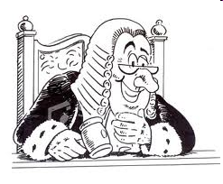
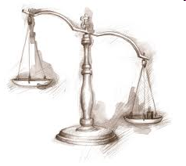
“It would take 466 years to clear backlog of cases piled in the Delhi High Courts if the system works with the same efficiency.”
- Hon Chief Justice A P Shah, Delhi High Court*
“Indian Judiciary would take 320 years to clear the backlog of 3.2 crore cases pending in various courts including high courts in the country.”
- Hon Justice V V Rao, A.P. High Court**
http://www.indianexpress.com/news/it-would-take-delhi-hc-466-yrs-to-clear-backlog-cj/423127/0
accessed on 20/01/2012
** http://articles.timesofindia.indiatimes.com/2010-03-06/india/28143242_1_high-court-judges-literacy-rate-backlog accessed on 15/01/2012
Notes:
1
5

Slide 6
Figures as on December 2015*
SC – 59,272
HCs – 38,75,014
Subordinate Courts – 2,71,00,951
--------------------------------------------
Total Pending Cases 3.10 Crore
What about Pendency in Quasi Judicial Bodies?
http://supremecourtofindia.nic.in/courtnews/Supreme%20Court%20News%20Oct-Dec%202016.pdf accessed on September 9, 2016
www.klgupta.in

Slide 7
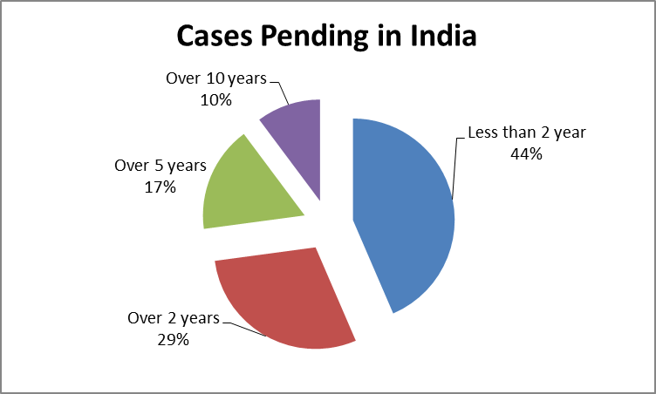
Source :- National Judicial Data Grid, July 2016
http://njdg.ecourts.gov.in/
www.klgupta.in

Slide 8
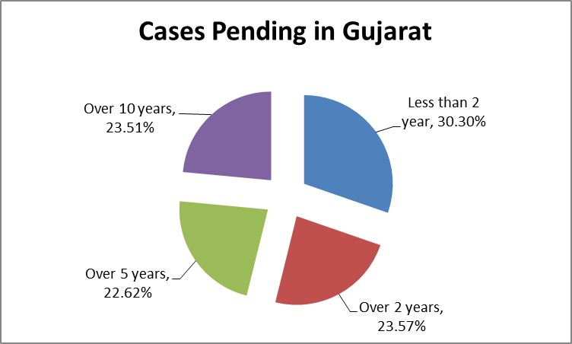
Source :- National Judicial Data Grid, July 2016
http://njdg.ecourts.gov.in/
www.klgupta.in

Slide 9
Vacancy ---- Figures as on September 2015
Name of Court | Sanctioned Strength | Working Strength | Vacancies | Vacancy %
SC | 31 | 28 | 5 | 16.12
HCs | 1016 | 611 | 405 | 39.86
DCs | 20574 | 15957 | 4617 | 22.44
Gujarat DCs | 1914 | 1181 | 733 | 38.29
Allahabad HC | 160 | 74 | 86 | 53.75
Gujarat HC | 52 | 28 | 24 | 46.15
Bombay HC | 94 | 59 | 35 | 37.23
http://supremecourtofindia.nic.in/courtnews/Supreme%20Court%20News%20Oct-Dec%202016.pdf accessed on September 9, 2016
www.klgupta.in

Slide 10
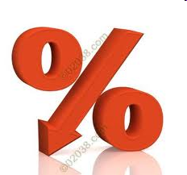
Sr. No. | Courts | Case Disposal Rate in Year 2005 (%) | Case Disposal Rate in Year 2010 (%)
A | Supreme Court of India | 58* | 59
B | High Courts
1 | Allahabad | 17 | 7
2 | Andhra Pradesh | 24 | 17
3 | Bombay | 27 | 10
4 | Calcutta | 23 | 5
5 | Gujarat | 40 | 18
6 | Delhi | 37 | 18
7 | Madras | 35 | 15
8 | Madhya Pradesh | 39 | 12
9 | Orissa | 19 | 23
10 | Punjab & Haryana | 18 | 13
11 | Rajashthan | 23 | 6
12 | Karnataka | 23 | 16
-- | Overall Rate for 21 High Courts | 27 | 11
C | District & Subordinate Courts | 39 | 15
Case
Disposal
Rate
www.klgupta.in
(C) K L GUPTA
Source :- www.supremecourtofindia.nic.in
*Data is of year 2006, Year 2005 is NA
Notes:
1
10

Slide 11
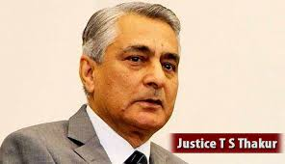
Chief Justice TS Thakur Breaks Down Before PM Modi, Says Need More Judges
How can 18,000 judges tackle 3 crore cases, CJI TS Thakur asks PM Modi
www.klgupta.in

Slide 12
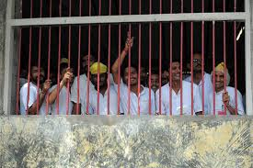
Prison Statistics 2014
Total Jails in the country 1387
Total capacity of jails in the country 3,56, 561
Total Jail Inmates as on 31/12/2014 4,18,536
Occupancy rate 2012 – 112.2%, 2013 – 118.4%, 2014- 117.4%
Under trails 67.6%
63,256 inmates were trained
www.klgupta.in

Slide 13
226 cases relating to under-trial prisoners are pending for more than ten years and 52 under-trial prisoners are in jail for more than ten years;
…………over 18,000 cases of under-trial prisoners are pending for more than three years of which 80% cases are concentrated in seven states;
Taken from Resolutions adopted in the chief justices' conference, 2016
http://supremecourtofindia.nic.in/FileServer/2016-05-06_1462510021.pdf
www.klgupta.in

Slide 14
Areas of Business Regulation
Sr. No. | Indicator Set | What is measured?
1 | Starting a business | Procedures, time, cost and paid in minimum capital to start a limited liability company
2 | Dealing with construction permits | Procedure, time and cost to complete all formalities to build a warehouse and the quality control and safety mechanism in the construction permitting system
3 | Getting electricity | Procedures, time and cost to get connected to the electrical grid, the reliability of the electricity supply and the cost of electricity consumption
4 | Registering Property | Procedures, time and cost to transfer a property and the quality of land administration system
5 | Getting Credit | Movable collateral laws and credit information system
6 | Protecting Minority Interest | Minority Shareholders’ rights in related-party transaction and in corporate governance
7 | Paying taxes | Payments, time and total tax rate for a firm to comply with all tax regulations.
8 | Trading Across Borders | Time and cost to export the product of comparative advantage and import auto parts.
9 | Enforcing Contracts | Time and cost to resolve a commercial dispute and the quality of judicial processes.
10 | Resolving Insolvency | Time, cost, outcome and recovery rate of a commercial insolvency and the strength of the legal framework for insolvency
11 | Labour Market Regulation | Flexibility in employment regulation and aspects of job quality
http://www.doingbusiness.org/rankings
www.klgupta.in

Slide 15
Country | Ease of Doing Business Rank | Starting a Business | Dealing with Construction Permits | Registering Property | Paying Tax | Enforcing Contracts
Singapore | 1 | 10 | 1 | 17 | 5 | 1
New Zealand | 2 | 1 | 3 | 1 | 22 | 15
Denmark | 3 | 29 | 5 | 9 | 12 | 37
Korea | 4 | 23 | 28 | 40 | 29 | 2
Hong Kong | 5 | 4 | 7 | 59 | 4 | 22
UK | 6 | 17 | 23 | 45 | 15 | 33
USA | 7 | 49 | 33 | 34 | 53 | 21
Sweden | 8 | 16 | 19 | 11 | 37 | 24
Norway | 9 | 24 | 26 | 13 | 14 | 8
Finland | 10 | 33 | 27 | 20 | 17 | 30
Taiwan, China | 11 | 22 | 6 | 18 | 39 | 16
Germany | 15 | 107 | 13 | 62 | 72 | 12
France | 27 | 32 | 40 | 85 | 87 | 14
UAE | 31 | 60 | 2 | 10 | 1 | 18
Japan | 34 | 81 | 68 | 48 | 121 | 51
Bhutan | 71 | 91 | 79 | 51 | 28 | 50
Saudi Arabia | 82 | 130 | 17 | 31 | 3 | 86
Nepal | 99 | 105 | 78 | 72 | 124 | 134
Sri Lanka | 107 | 98 | 77 | 153 | 158 | 161
Brazil | 116 | 174 | 169 | 130 | 178 | 45
India | 130 | 155 | 183 | 138 | 157 | 178
Pakistan | 138 | 122 | 61 | 137 | 171 | 151
Bangaldesh | 174 | 117 | 118 | 185 | 86 | 188
Ease of Doing Business Rankings
http://www.doingbusiness.org/rankings
www.klgupta.in

Slide 16
Hussainara Khatoon v/s. Home Secretary, State of Bihar (AIR 1979 SC 1360)
The Supreme Court held in this case the Speedy Trial is a Fundamental Right implicit in the guarantee of life and personal liberty enshrined in Article 21 of the Constitution.
Supreme Court, therefore, in order to exercise this power and make this fundamental right meaningful to the prisoners in the State of Bihar………
request the High Court to inform as to how many Sessions
Judges, Additional Sessions Judges and Assistant Sessions
Judges are there in each district in State of Bihar and what is
the number of cases year wise pending before each of them.
Also asked for the details of need of additional courts and steps taken by state government to meet this needs.
www.klgupta.in
Notes:
1
16

Slide 17
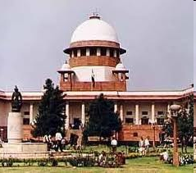
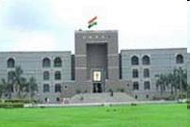
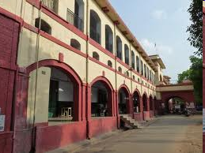
Supreme Court
High Court
Lower Court
Notes:
1
17

Slide 18
Rs. 35 crore study to find effect of backlog on judges minds :-
The Centre has agreed to conduct a study to find how the 14,000-odd trial court judges have been psychologically impacted by the continuous struggle to fight off 2.77 crore pending cases.
Government announced that they are ready to sanction Rs 35 crore for a five-year study to investigate the impact of pendency pressure on judicial officers and examine whether it adversely impacted the output of trial court judges
Amicus curiae and Senior Advocate Gopal Subramaniam, assisting a bench of Justices A K Ganguly and T S Thakur in overall improvement of justice delivery system, had felt that heavy work load for a long period of time could cause psychological pressure on the judicial officers.
*http://timesofindia.indiatimes.com//articleshow/11443666.cms?intenttarget=no accessed on 15/01/2012
www.klgupta.in
Notes:
1
18

Slide 19
Who is responsible for delay in cases ?
www.klgupta.in

Slide 20
Indian Judicial System
Pendency of Cases – Who is Responsible?
www.klgupta.in

Slide 21
Reasons for Delay in Cases
www.klgupta.in

Slide 22
Judges
Less no of judges, Inefficient judges, low disposal rate
Advocates
Decision Maker, Misleading courts, & litigants, Public Prosecutor
Govt.
No recruitment for judicial function, infrastructure, less funding, digitization, uniform policy for all courts, Poor police investigation, govt. as biggest litigant
Litigants
Filing unnecessary cases, delaying cases. Not interested in ADR,
Absence of Proper Court Management
www.klgupta.in

Slide 23
Solution for Speedy Disposal
www.klgupta.in

Slide 24
Judges
Filling up the vacancies, proper training
Advocates
Guiding/Educating the litigants rather than decision maker, Professional ethics in profession
Govt.
Appointment of more judges, staff, more funding for judicial functions, digitization, training police department, avoid litigation
Litigants
Cooperation in disposal of cases, avoid unnecessary litigations. Go for ADR, out of court settlement
Proper Court Management
www.klgupta.in

Slide 25
Outline of Presentation
Introduction
Court Management
Indian Judiciary – Way Forward
www.klgupta.in

Slide 26
National Association for Court Management
(NACM)
National Association for Court Management c/o Association Management National Center for State Courts 300 Newport Avenue Williamsburg, VA 23185-4147, USA
www.klgupta.in

Slide 27
Scheme
The National Association for Court Management (NACM) is a non-profit organization in the United States that promotes professional management education for court administrators and judges.
Founded in 1985
www.klgupta.in

Slide 28
Objective of NACM
Develop and improve leadership in the judicial system and the leadership qualities of court managers.
Promote the interdependence of court managers and judges.
Promote and encourage the continuing education opportunities of court managers.
Encourage fellowship, a network, and a sense of unity among NACM members.
Educate the public on the role and importance of courts.
Enhance public access to the courts.
Recognize the diversity of NACM's membership and encourage broad participation in NACM governance and activities.
www.klgupta.in

Slide 29
Objective of NACM
Enhance and improve NACM publications and related activities.
Enhance NACM's organizational vitality through a continuing review process and a focus on the future for courts.
NACM collaborates in training programms with Michigan State University, National Centre for State Courts (NCSC, 1971)* and Institute of Court Management.
In 2014, NACM has also drafted a Model Code of Conduct for Court Professionals.
*(NCSC) is a non-profit organization charged with improving judicial administration in the United States and around the world. It functions as a think-tank, library, non-profit consulting firm for the courts, advocate for judicial and legislative reform, and a center of education in the field of judicial administration
www.klgupta.in

Slide 30
National Court Management System
(NCMS)
Proposed by
Supreme Court of India
www.klgupta.in

Slide 31
Scheme*
Objectives
Looking at this, the Hon’ble Chief Justice of India S H Kapadia expressed a desire to establish comprehensive Court Management Systems for the country that will enhance quality, responsiveness and timeliness of courts.
The NCMS systems will be under overall control of Chief Justice of India. It will primarily deal with policy issues.
www.klgupta.in
*Policy & Action Plan September 27, 2012

Slide 32
1. National Framework of Court Excellence (NFCE)
5. Court Development Planning System
6. Human Resource Development Strategy
2. A System for monitoring and enhancing performance
3. System of Case Management
4. National System of Judicial Statistics
6 Elements of NCMS
www.klgupta.in

Slide 33
Effective Integration of National Court Management Systems and State Court Management Systems.*
Resolved that
periodical meetings be held of SCMSs in each High Court;
vision statements be prepared on the basis of the National Vision Statement formulated by the Committee of three Chief Justices in the Conference held in April 2015;
Secretaries be appointed to facilitate the work of SCMSs;
constitution of SCMSs be rationalized and a permanent secretariat be set up;
District Sub Committees be constituted; and
SCMSs monitor the performance of respective courts in achieving a 'Five Plus Zero' pendency and to implement a pilot project on quality, timelines and efficacy of judicial decision-making.
* Taken from RESOLUTIONS ADOPTED IN THE CHIEF JUSTICES’ CONFERENCE, 2016 [22ND & 23RD APRIL, 2016] http://supremecourtofindia.nic.in/FileServer/2016-05-06_1462510021.pdf
www.klgupta.in

Slide 34
MBA in Court Management
By
NALSAR, Hyderabad
www.klgupta.in

Slide 35
‘Court management’ degree proves a flop in Nalsar MBA: College now scrambles to find corporate jobs for 46 MBA grads
Source :- http://www.legallyindia.com/Law-schools/nalsar-hyderabad-mba-program-progress-report
www.klgupta.in

Slide 36
Model of National Court Management Authority
(NCMA)
Proposed by
Kalpeshkumar L Gupta
www.klgupta.in

Slide 37
Ministry of Law & Justice
Department of Justice
National Court Management Authority (NCMA)
Supreme Court
National Level Quasi Judicial Bodies
Regional Case Management Authority (RCMA)
High Courts
District Courts
Subordinate Courts
Regional Level Quasi Judicial Bodies
Special Body for Special Cases i.e. of National /State Importance
MODEL 1
Set up of National Court Management Authority (NCMA)
www.klgupta.in

Slide 38
Ministry of Law & Justice
Law Commission of India
National Court Management Authority (NCMA)
Supreme Court
National Level Quasi Judicial Bodies
Regional Case Management Authority (RCMA)
High Courts
District Courts
Subordinate Courts
Regional Level Quasi Judicial Bodies
Legislative Reform Body
Special Body for Special Cases i.e. of National /State Importance
MODEL 2
Set up of National Court Management Authority (NCMA)
www.klgupta.in

Slide 39
National Case Monitoring Authority
(February, 2012)
National Case Management Authority
(October, 2012)
National Court Management Authority
(November, 2012)
“Delayed Justice – Denial of Fundamental Rights”
“Transparency in Governance is the Ultimate Key to Reforms”
www.klgupta.in
Transition of NCMA
(C) K L GUPTA
Notes:
1
39

Slide 40
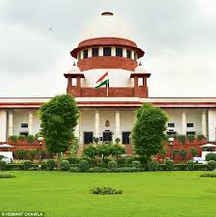
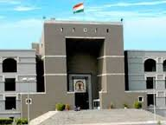
Mr. Kalpeshkumar L Gupta vs Supreme Court Of India on 12 April, 2013
Central Information Commission, New Delhi File No.CIC/SM/A/2012/001719 Right to Information Act­2005­Under Section (19)
Date of hearing : 12 April 2013 Date of decision : 12 April 2013
RTI Filed….
How SC/HC monitors the cases?
Any mechanism to monitoring of the case?
www.klgupta.in
(C) K L GUPTA
Notes:
1
40

Slide 41
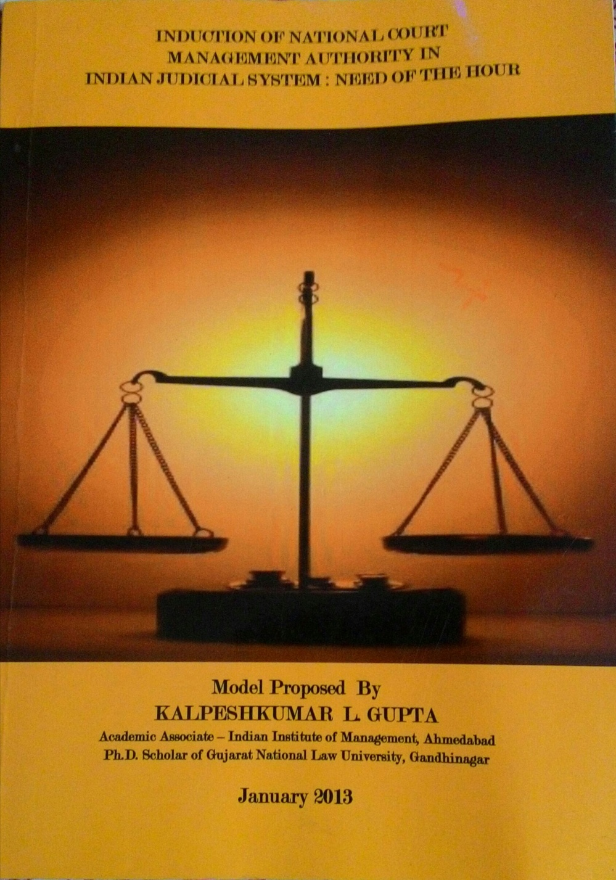
www.klgupta.in
(C) K L GUPTA
Notes:
1
41

Slide 42
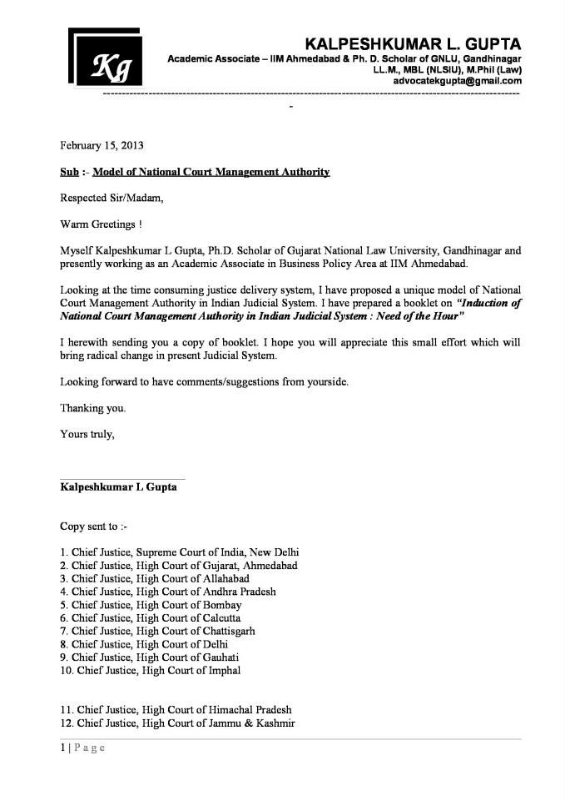
www.klgupta.in
(C) K L GUPTA
Notes:
1
42

Slide 43
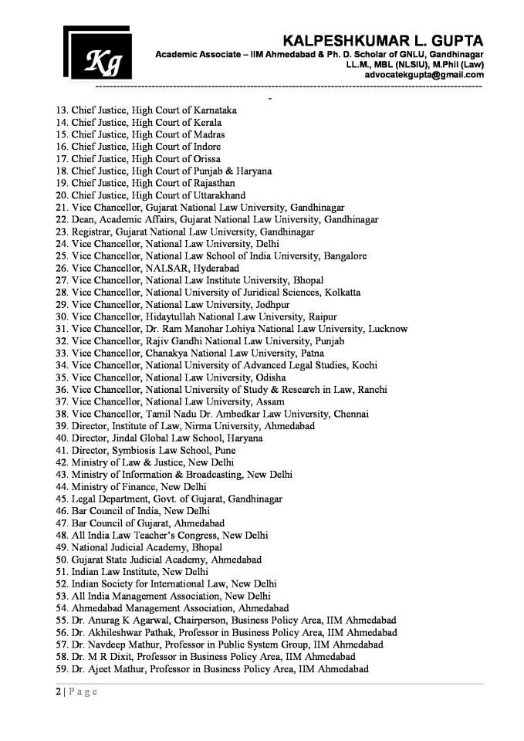
www.klgupta.in
(C) K L GUPTA
Notes:
1
43

Slide 44
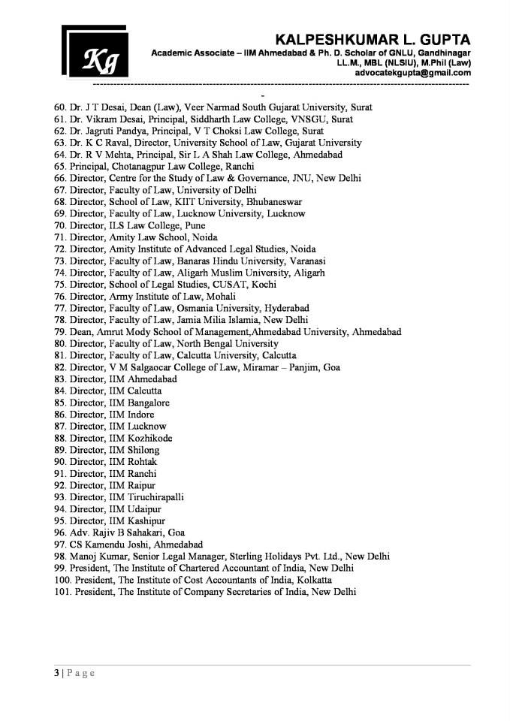
www.klgupta.in
(C) K L GUPTA
Notes:
1
44

Slide 45
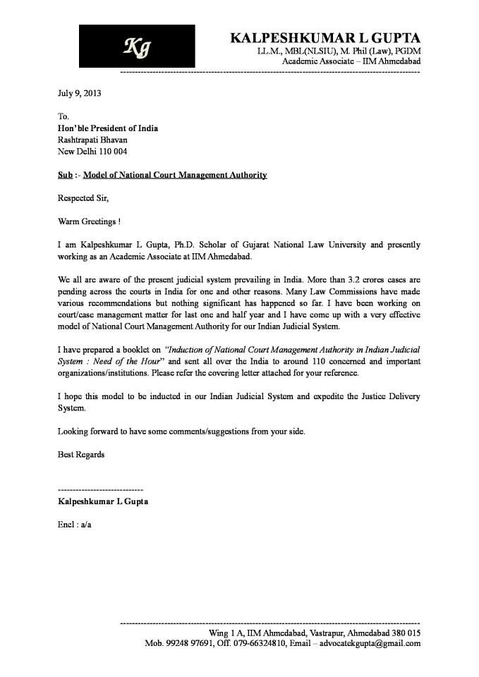
www.klgupta.in
(C) K L GUPTA
Notes:
1
45

Slide 46
National Court Management Authority (NCMA)
Court Manager at Supreme Court
Court Manager at High Courts
Court Manager at District Courts
Court Manager Quasi Judicial Bodies
Appointment of Court Manager under Guidelines issued by 13th Finance Commission for Improvement in Justice Delivery (No. F 32(30) FCD/2010, September 20, 2010
www.klgupta.in

Slide 47
NCMA
Court Manager
Court Manager
Court Manager
Court Manager
Appointment of Court Manager under Guidelines issued by 13th Finance Commission for Improvement in Justice Delivery (No. F 32(30) FCD/2010, September 20, 2010
www.klgupta.in

Slide 48
Suggested Functions of Court Manager:-
1. Policies & Standards
2. Planning
3. Information & Statistics
4. Court Management
5. Case Management
6. Responsiveness Management
7. Quality Management
8. Human Resource Management
9. Core System of Management
10. IT System Management
Appointment of Court Manager under Guidelines issued by 13th Finance Commission for Improvement in Justice Delivery (No. F 32(30) FCD/2010, September 20, 2010
www.klgupta.in

Slide 49
Qualification of Court Manager:-
Court Managers may have the following minimum qualifications:
1. A degree or advanced diploma in general management;
2. 5 years’ experience/training in system and process management;
3. 5 years’ experience/training in IT system management, HR management, financial system management;
4. Excellent people skill;
5. Excellent communication skill;
6. Excellent computer application skill.
Appointment of Court Manager under Guidelines issued by 13th Finance Commission for Improvement in Justice Delivery (No. F 32(30) FCD/2010, September 20, 2010
www.klgupta.in

Slide 50
Advertisement for the post of Court Manager :-
Name of High Court | No of Post Advertised
High Court of Madras | 33
High Court of Allahabad | 75
High Court of Mumbai | 45
High Court of Rajasthan | 38
High Court of Madhya Pradesh | 54
High Court of Ranchi | 24
High Court of Punjab & Haryana | 34
High Court of Gujarat | 27
www.klgupta.in

Slide 51
Functions of NCMA :-
1. Monitoring the working of Judicial and Quasi-Judicial Bodies in India. It is more like of administrative, management part of the judicial system.
2. Study overall aspects of Indian Judicial System and do comprehensive analysis of it. At the end submit report to Department Justice/Law Commission of India with certain recommendations.
3. NCMA will play crucial role in monitoring of cases from its institution till its implementation. Consequently it will help to reduce backlog of cases lying in Indian Judiciary.
4. NCMA will mainly coordinate with Regional Case Management Authorities (RCMAs) and Court Managers of the Judicial and Quasi-Judicial Bodies.
RCMA will mainly co-ordinate with Court Managers appointed in High Courts, Districts Courts and Regional Level Quasi-Judicial Bodies
5. Conduct training and development programme for Court Managers
www.klgupta.in

Slide 52
Composition of NCMA :-
The NCMA shall consist of a Chairperson and not less than 6 and not more than 10 members to be appointed by the Central Government.
At the Regional Court Management Authority (RCMA) there will be a Chairperson and not less than 2 and not more than 4 members.
Chairperson must have sound knowledge of Management and Law more than 15 years of experience. He will be a person of ability, integrity and standing. Special knowledge in other domain area will be an added advantage.
Every members shall be a person of ability, integrity and standing and who has special knowledge of and such professional experience of not less than 15 years in management, it, human resource, public affairs or any other qualification which in the opinion of the Central Government may be useful to the Authority.
www.klgupta.in

Slide 53
Term of Office of Chairperson & Members:-
The Chairperson and every other member shall hold office as such for a term of 5 years from the date on which he enters upon his office and shall be eligible for re-appointment.
Provided that the Chairperson or other Members shall not held office as such after he has attained the age of 70 years.
www.klgupta.in

Slide 54
NCMA - No threat to Independence of Judiciary :-
No Threat to Independence of Judiciary
NCMA will act like facilitator for Indian Judiciary
www.klgupta.in
Notes:
1
54

Slide 55
Challenges :-
Dedicated Budget
Implementation
Being Permanent Body ?
www.klgupta.in
Notes:
1
55

Slide 56
Court Manager’s Concern in India
Organize the National Level Managerial Training Programs for Court Managers.
Common representation to Mr. Modi for regularize the post of court managers.
Non-Judicial Management Cadre
National Level Association and represent to Mr Modi.
Setting up of Unique Court Management System in India
- ………………………After two years of working in this system, I have lost my sense of innovation, initiatives and efficiency to quite an extent. I feel very helpless sometimes. "Can somebody tell me where can I buy a nuclear bomb online"
Source :- http://www.courtmanagersindia.com/ accessed on September 10, 2016
www.klgupta.in

Slide 57
Outline of Presentation
Introduction
Court Management
Indian Judiciary – Way Forward
www.klgupta.in

Slide 58
Delhi Bar Association v/s. Union of India (2002 10 SCC 159)
Essential Attributes for Selection of a Judicial Officer
What has to be seen is the potential in the candidate: whether a person is intelligent and will in due course of time become a good judge. It may not be necessary for him to be academically brilliant or knowing all the law at the time when the process of selection is undertaken.
What has to be seen is, whether the candidate has the attributes of becoming a good Judicial Officer, namely, integrity, honesty, basic knowledge of law and robust common sense.
www.klgupta.in

Slide 59
Vinay Kumar s/o Hukam Chand Sharma v/s. High Court of Gujarat (Special Civil Application 8793/2015, Dt. 16/08/2016)
In fact the qualities which the Judicial Officer would possess are delineated by the Hon’ble Supreme Court in the case of Delhi Bar Association v. Union of India, reported in (2002) 10 SCC 159. A judicial officer must, apart from academic knowledge, have the capacity to communicate his thoughts, he must be tactful, he must be diplomatic, he must have a sense of humour, he must have the ability to defuse situations, to control the examination of witnesses and also lengthy irrelevant arguments and the like. Existence of such capacities can be brought out only in an oral interview.
It is imperative that only persons with a minimum of such capacities should be selected for the judiciary as otherwise the standards would get diluted and substandard stuff may be getting into the judiciary.
Delivered by CJI R Subhash Reddy, J Vipul M Pancholi)
www.klgupta.in

Slide 60
The Role of Law Schools in Educating Judges to Increase Access to Justice
(Sande Buhai, Ved Kumari, Amari Omaka, Stephen A Rosenbaum, Supriya Routh)
Global Business & Development Law Journal, Vol. 24 Issue 1
What is important to notice is that the skill sets required by a lawyer are very different from the skills required by a judge.
Judicial Education in curriculum for rounded view of judicial administration
Community Lawyering.
Judge Ammy lobbies very effectively for an LL.M. programme that would be open to potential judicial candidates and to others who have an interest in the ethics, workings and effectiveness of the court. Judge Ammy notes the two established programme for judges: University of Virginia’s LL.M. programme for appellate judges and the National Judicial College’s master programme for trial judges.
www.klgupta.in
Cont…

Slide 61
Cont…
The Role of Law Schools in Educating Judges to Increase Access to Justice
Global Business & Development Law Journal, Vol. 24 Issue 1
In response to the question, "At what point in your career did you begin to focus on becoming a judge?," only one person responded that his/her interest in the judiciary had been aroused in law school, ' ……………..a clear indicator that there is room for more focus by law schools on preparation for the judiciary. (Survey Various courts City of New York)
www.klgupta.in

Slide 62
Recent Trends in Business Laws
Multinational Companies vis a vis Legal & Regulatory Environment in India
Paper presented at International Conference @ NLSIU, Bangalore, July 2016
Need of Regulation Impact Assessment
Amendment in Arbitration
Commercial Court
National Company Law Tribunal
Insolvency & Bankruptcy
www.klgupta.in

Slide 63
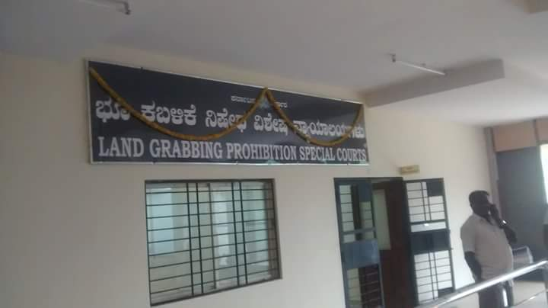
Karnataka Land Grabbing (Prohibition) Act, 2011
2 Special Court Stared August 31, 2016
www.klgupta.in

Slide 64
Has NCMA Model Appealed to you?
www.klgupta.in

Slide 65
Kalpeshkumar L Gupta
www.klgupta.in
advocatekgupta@gmail.com

